Slide 1


Consumerism and
Ethical Responsibility

Slide 2
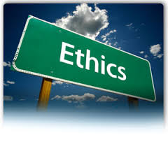
What is consumer ethics?
Ethics can be defined as the study of morality, standards that determine what is right and what is wrong, good and evil, helpful or harmful, acceptable or unacceptable. Ethics is concerned with any situation where there is actual or potential harm to any individual or group from a particular course of action.

Slide 3
Consumerism
This arises because of the failure of businesses in the exchange relationship to meet and respond to legitimate demands of the consumer.

Slide 4
Ethical Perspectives
Utilitarian
Justice and fairness
Theory of personal rights

Slide 5
Utilitarian perspective
This talks of the greatest good for the greatest number as opposed to the concerns of a single individual or enterprise

Slide 6
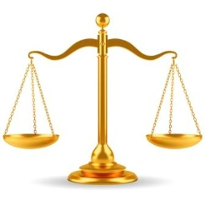
Justice and fairness
This believes that impartiality and fairness are the criteria for ethical decision making. Justice is attained when the benefits of and burdens of society are distributed fairly to stakeholders, unless there are clear and defensible reasons for differential treatment

Slide 7
Theory of Personal Rights
Individuals have rights ensuring their dignity, respect and autonomy. Rights are powerful devices whose main purpose is that of enabling the individual to choose freely whether to pursue certain interests or activities and of protecting those choices.

Slide 8
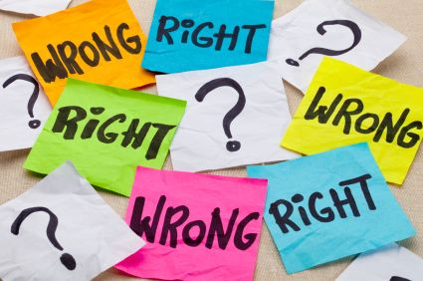
Justifiable actions
An action is morally justifiable if and only if a person’s rationale for carrying out that action in a given situation is one that person would be willing to have everyone else use in a similar situation.

Slide 9

Conflict between ethics and bottom line responsibility
No clear cut answer
Individuals would have to introspect and answer this
By and large, there is a high correlation between ethical behaviour of the organisation and its prosperity.

Slide 10
Consumer Rights
Right to safety
Right to be informed
Right to choose
Right to be heard
Right to enjoy a clean and healthful environment
Right of the poor and other minorities to have their interests protected

Slide 11

Right to Safety
Consumers have the right to be protected against products and services that are hazardous to health and life

Slide 12
Issue of costs vs benefits
Deontological
Irrespective of the costs, if life is endangered, those costs should be incurred
Teleological
By incurring additional costs lower income consumers get priced out of the market. Is that desirable?

Slide 13

Right to be informed
The consumer has the right to be protected against fraudulent, deceitful or grossly misleading information, advertising, labeling, or other practices, and to be given the facts that (s)he needs to make an informed choice

Slide 14
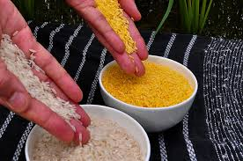
Right to choose
Consumers have the right to assured access, to a variety of products and services at competitive prices. In those industries in which competition is not workable, government regulation is substituted to assure unsatisfactory quality and service at fair prices.

Slide 15
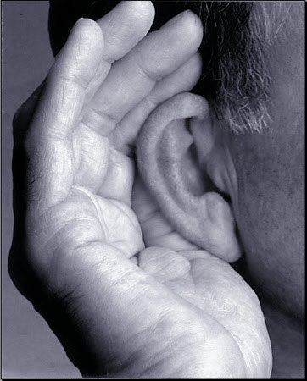
Right to be heard
(redress)
Consumers have the right to be assured that consumer interests will receive full and sympathetic consideration in the formulation of Government policy and fair and expeditious treatment in its administrative tribunals

Slide 16
Right to enjoy a clean and healthful environment
Environmental Issues
Pollution Issues

Slide 17
Rights of the poor and special interest groups
BPL Strata
Elderly People
Children

Slide 18
Dealing with consumer rights
Taking responsibility
Improving the quality of customer contact
Providing for redress
Providing customer education

